Slide 1
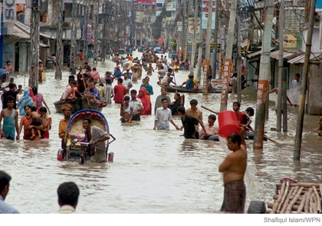
Global Warming the Future Documentary 2019
Student’s Name
Institution
Course
Date

Slide 2
Introduction
One of the greatest threats associated with global warming is the rising sea levels seen in cities like New York (USA), New Orleans (USA), Vancouver (Canada), Venice (Italy) and Dhaka (Bangladesh).
The melting Antarctica caused by the rising earth temperature contributes to the increasing sea level that results into the flooding.
But are these projections a myth or a reality? This has been the questions that proponents and opponents of global warming have been asking themselves about the future.

Slide 3
Introduction Continued.
The scope of this paper is to evaluate the feasibility of the postulation by most scientists that an increasing temperature in the globe contributes to the rising sea levels.

Slide 4
Prediction of Global Warming
Prediction of the rising sea levels is difficult since the world has not recorded such a dramatic amount of carbon in the last century (Abdullah, 2017).
Professor Stefan Rahmstorf’s model, an oceanographer and climatologist from the Potsdam University, predicts a sharp increase in the water levels with the he spikes in temperature (TL Documentary, 2019).

Slide 5
Prediction of Global Warming Continued
The scientist indicates that one clear indication of an increase in the water levels is gradual flooding of the coastal region. The scholar indicates that property nearest to the sea are the first ones to flood before water breaks the flood defences to flow inland.

Slide 6
Prediction of Global Warming Continued
Besides the destruction of property, the scholar also indicates that impact of a hurricane in such situations whereby water levels have risen.
Furthermore, this rising levels also poses a risk to most ports since a 5 to 6-foot rise in water might result into massive flooding.

Slide 7
Miami Dade County Flooding
Miami Dade County might be fully flooded by the year 2100. Professor Harold Wanless, chairman of Geology University of Miami, cites that within a 100 years, most of Miami will be under 4 to 6 feet of water (TL Documentary, 2019).
The scholar also notes that human beings are helpless against the rising sea level and the option they will have then will be migration into higher grounds.

Slide 8
Miami Dade County Flooding Continued
The excessive flooding attenuated with hurricanes is an implication of the rising sea levels caused by global warming.
These floods have been massive to the level of breaking the levees and flood walls. The situation in New Orleans is an example of how sea levels have risen and resulted in area wide flooding of whole neighbourhoods and districts.

Slide 9
Recommendation-New Orleans Flood Defense
The American government in investing billions of dollars in constructing flood defences around cities like New Orleans.
The expensive project is being executed by the Army Corps of Engineer and is said to feature the next generation of flood defence.

Slide 10
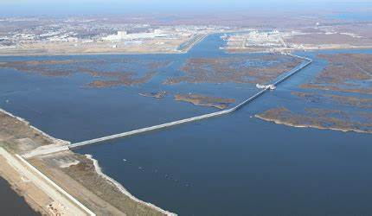
The New Orleans Flood Defense- Aerial View

Slide 11
Recommendation-New Orleans Flood Defense Continued
The protection system around New Orleans serves to protect the city from water from the Mississippi River to and Lake Pontchartrain.
This system involves a protective wall built 12 miles off the coast of the city to act as the first line of defence.
The defense system includes canal pumps, the Great Wall of Louisiana and the gate.

Slide 12
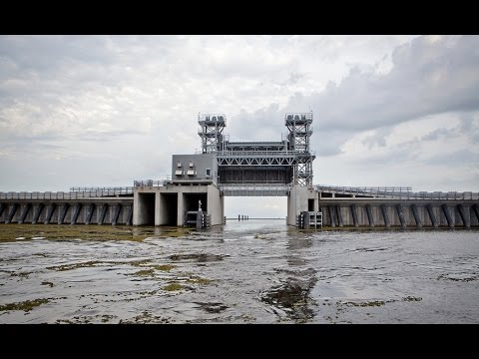
The Great Wall of Louisiana- Passage for Ships

Slide 13
Recommendation-New Orleans Flood Defense Continued
Additionally, the system also employs the use of levees, water pumps and flood walls in preventing the flow of water inland.
Alternatively, coffer dams have also been used to allows for modification on the walls to allow passage of ships.

Slide 14
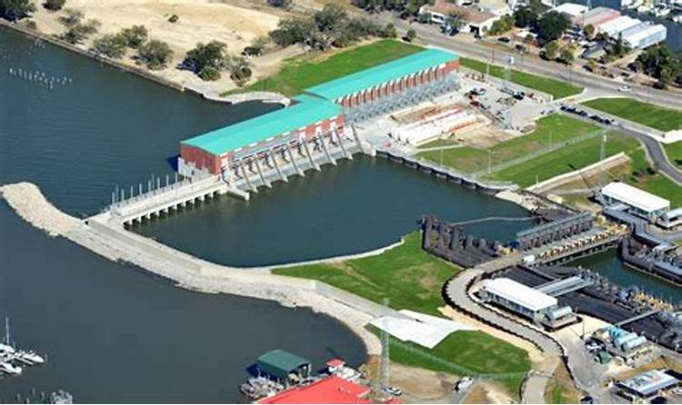
The New Orleans Flood Defense- Canal Pumps and Levees

Slide 15
Conclusions
Countries like Bangladesh continue to suffer the repercussion of the rising sea level.
Most of the residential areas close to the Indian ocean being 1 foot under water.
Additionally, the rice growing deltas near the sea are also among the most affected areas.

Slide 16
Conclusions Continued
Therefore, continued rising water possess a huge threat to the Bangladesh rice farmers as most of them will lose their land to the increasing water levels.

Slide 17
References
Abdullah, S. M. (2017). Carbon dioxide emissions causing global warming. New Straits Times, 13
TL Documentary. (2019, November 8). Global Warming The Future - Full Documentary 2019 HD. YouTube. https://www.youtube.com/watch?v=uOMRF7t5Vn0

